Slide 1
Handshake Tutorial

Slide 2
What is Handshake?
Handshake is a career search application that will help you get through the recruiting process seamlessly!

Slide 3
How it Works?
Step1: Create a free account on joinhandshake.com/student_account_registrations/new#/email/
Enter your .edu email address to get started.
Example: johndoe@csu.fullerton.edu

Slide 4
Fill out your profile.
Step 2: Fill in required fields such as job prefrences, location, and industries you would like to work in.
80% of students who complete a Handshake profile recieve a message from a recruiter.

Slide 5
Apply to jobs.
Step 3: Handshake has the ability to let you apply to jobs through the platform. It will offer you personalized job recommendations, save the jobs you like, and apply when you are ready.

Slide 6
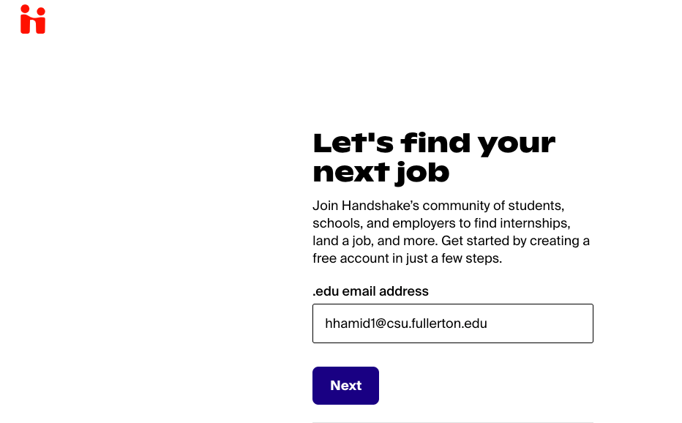
Browser Application
Step 1: app. joinhandshake.com/student_account_registrations/new#/email

Slide 7
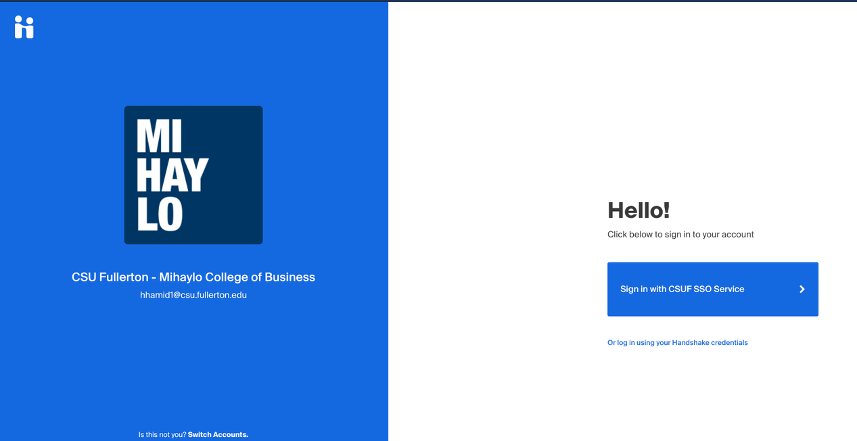
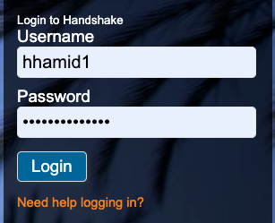
Step 2: Sign in with CSUF SSO Service

Slide 8
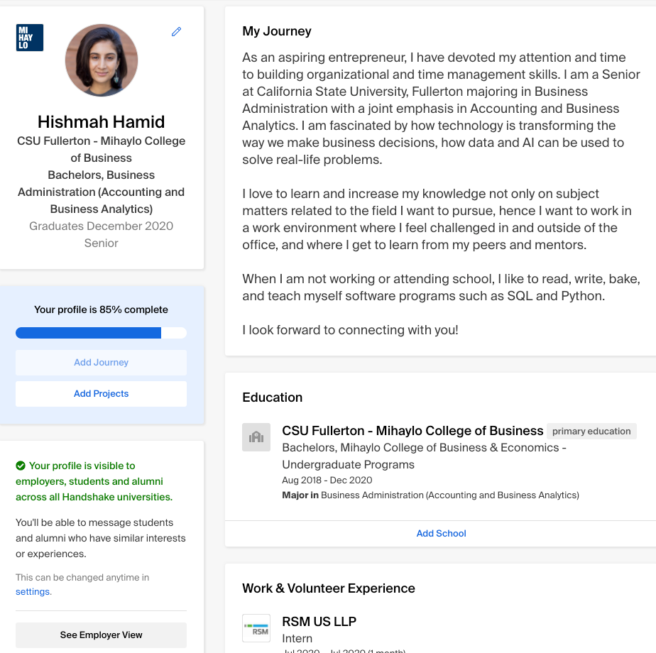
Step 3: Build your profile

Slide 9
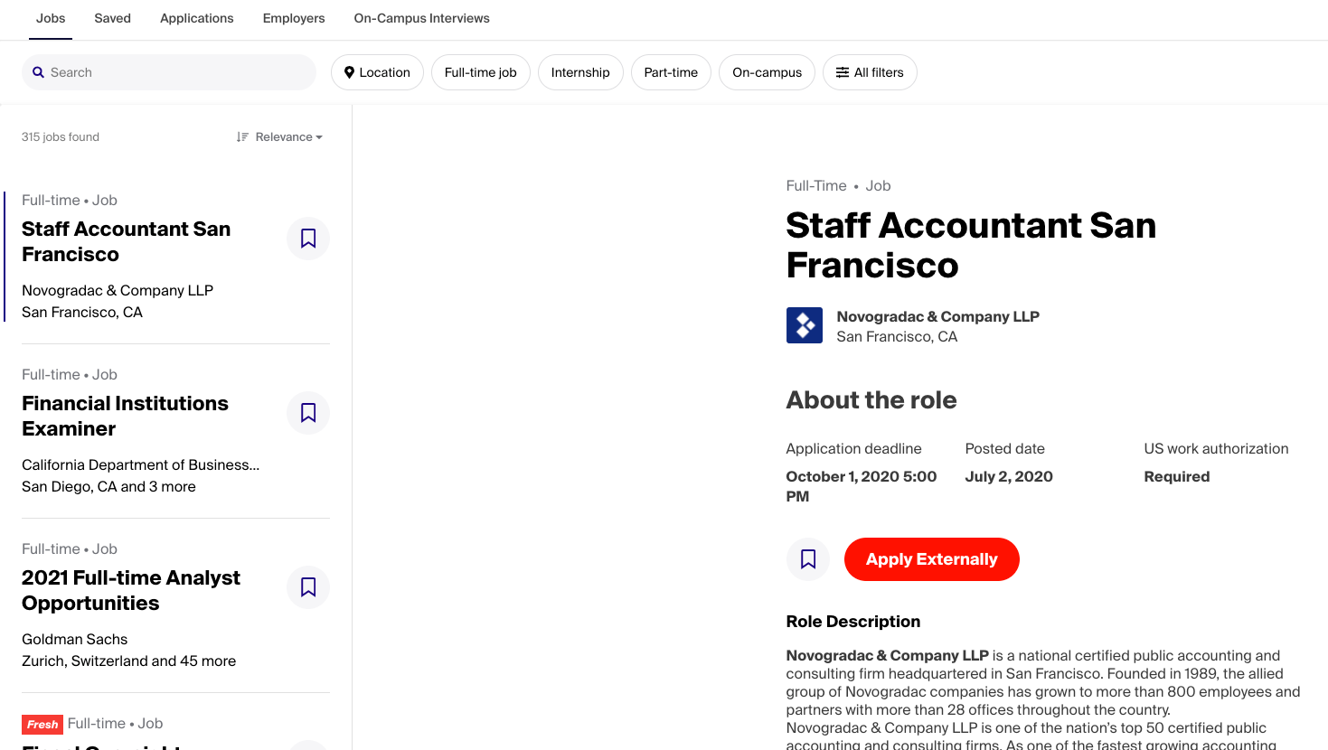
Step 4: Research Jobs and Apply Online

Slide 10
Tips for Success
Do your research.
See what job and position best fit your skills.
Follow employers through Handshake.
Build your Handshake profile as you would build your LinkedIn profile.
Have fun and enjoy the process.

Slide 11
Thank You

